Slide 1
FOREIGN AND DEFENSE POLICY MAKING
LUC OLSTHOORN TRIPP JOACHIM
CHRIS OSTER

Slide 2
ANSWERED QUESTIONS

Slide 3
What should be the role of the worlds only remaining superpower in defense policy?
Increase its presence in countries susceptible to foreign influence

Slide 4
What should be done with our huge defense establishment?
Should be reduced to an economically bearable level which doesn't create unnecessary debt

Slide 5
What role do the American people have in foreign policy?
Their will and opinion is reflected in foreign policy but may be overwhelmed by consumerist mentalities
Should they ^ have a larger role? Yes in order to prevent the overinfluence of "wealthy individuals and institutions"

Slide 6
TERMS TIME

Slide 7
Foreign policy
A government's strategy in dealing with other nations.

Slide 8
United Nations
An international organization composed of most of the countries of the world. It was founded in 1945 to promote peace, security, and economic development.

Slide 9
NATO
The North Atlantic Treaty Organization, also called the North Atlantic Alliance, is an intergovernmental military alliance

Slide 10
European Union EU
The European Union is a politico-economic union of 28 member states that are located primarily in Europe. The EU operates through a system of supranational institutions and intergovernmental negotiated decisions by the member states

Slide 11
Secretary of State
The head of the State Department, responsible for foreign affairs.

Slide 12
Security of defense
The leader and chief executive officer of the Department of Defense, an Executive Department of the Government of the United States of America.

Slide 13
Joint chiefs of staff
The chiefs of staff of the US Army and Air Force, the commandant of the US Marine Corps, and the chief of US Naval Operations. This group's chairman, selected from one of the branches, is the highest-ranking military adviser to the president of the US.

Slide 14
CIA
The Central Intelligence Agency (CIA) is one of the principal intelligence-gathering agencies of the United States federal government.

Slide 15
Isolationism
A policy of remaining apart from the affairs or interests of other groups, especially the political affairs of other countries.

Slide 16
Containment Doctrine
A United States foreign policy doctrine adopted by the Harry S. Truman administration in 1947, operating on the principle that communist governments will eventually fall apart as long as they are prevented from expanding their influence.

Slide 17
Cold War
A state of political hostility between countries characterized by threats, propaganda, and other measures short of open warfare, in particular.

Slide 18
THE cold war
The state of political hostility that existed between the Soviet bloc countries and the US-led Western powers from 1945 to 1990.

Slide 19
McCarthyism
A vociferous campaign against alleged communists in the US government and other institutions carried out under Senator Joseph McCarthy in the period 1950–54. Many of the accused were blacklisted or lost their jobs, although most did not in fact belong to the Communist Party.

Slide 20
Arms Race
A competition between nations for superiority in the development and accumulation of weapons, especially between the US and the former Soviet Union during the Cold War.

Slide 21
Detente
The easing of hostility or strained relations, especially between countries.

Slide 22
Strategic Defense Initiative
Also known as Star Wars, was a program first initiated on March 23, 1983 under President Ronald Reagan. The intent of this program was to develop a sophisticated anti-ballistic missile system in order to prevent missile attacks from other countries, specifically the Soviet Union.

Slide 23
Interdependency
Is mutual dependence between things.

Slide 24
Tariff
A tax or duty to be paid on a particular class of imports or exports.

Slide 25
Balance of trade
The difference in value between a country's imports and exports.

Slide 26
OPEC
A cartel that aims to manage the supply of oil in an effort to set the price of oil on the world market, in order to avoid fluctuations that might affect the economies of both producing and purchasing countries.

Slide 27
Diplomacy
the profession, activity, or skill of managing international relations, typically by a country's representatives abroad.

Slide 28
MULTIPLE CHOICE TIME

Slide 29

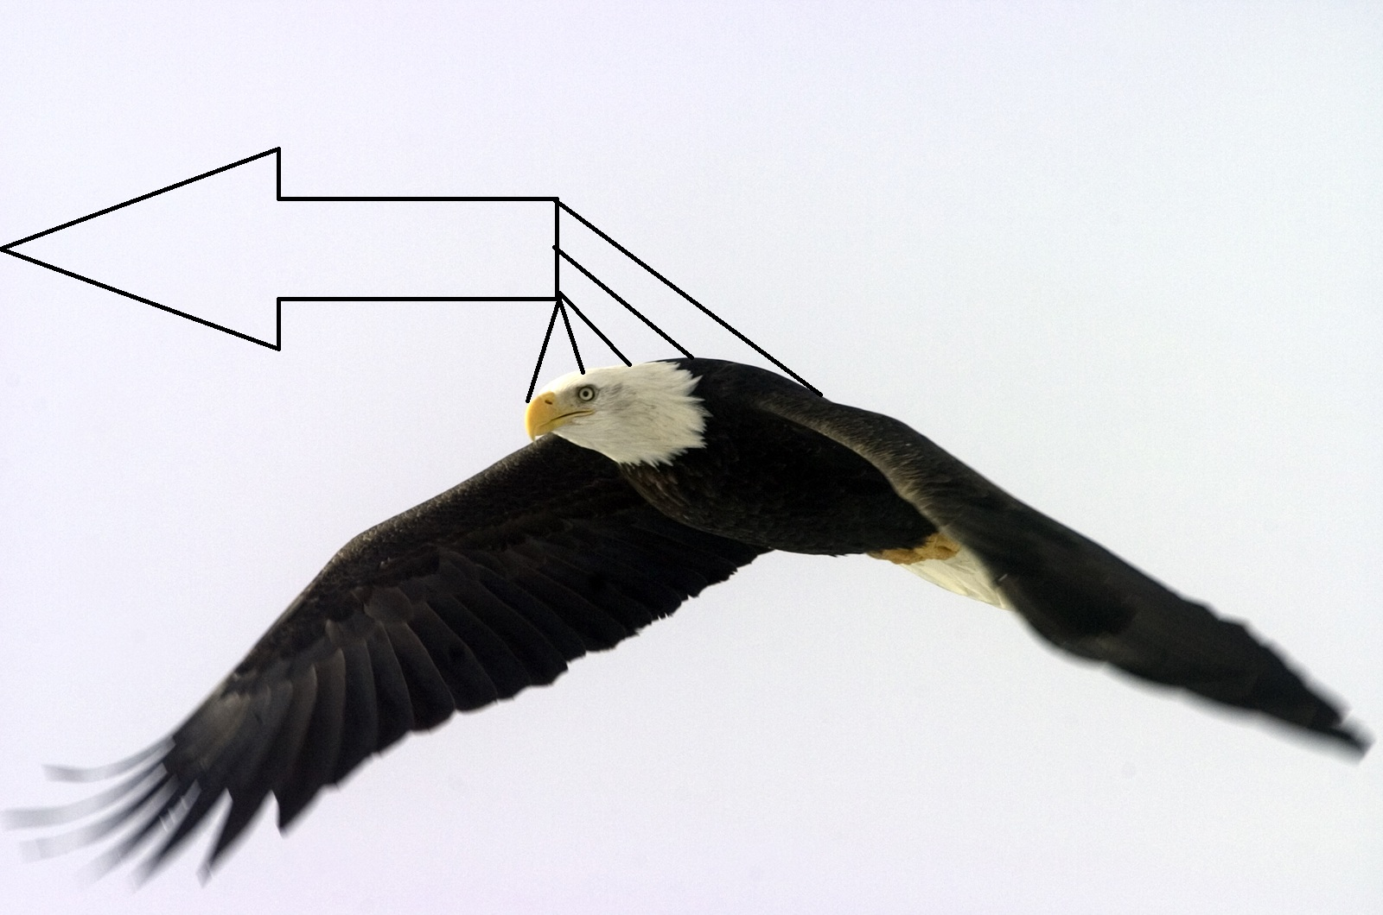
What was the previous name for the secretary of defense renamed by
A HOUSE OF CARDS
B SECRETARY OF FOREIGN POLICY
C SECRETARY OF WAR
D SECRETARY OF AFFAIRS
E HEAD OF DEFENSE

Slide 30
Who makes our defense policy
A CONGRESS
B FIRST LADY
C THE PRESIDENT
D SECRETARY OF STATE
E THE MILITARY

Slide 31
What is the percentage of defense spending
A 10%
B 15%
C 20%
D 30%
E 31.72345%

Slide 32
Which of the following doesn’t play a role in foreign policy making
A THE PRESIDENT
B DIPLOMATS
C SUPREME COURT
D NATIONAL SECURITY DIPLOMATS
E CONGRESS

Slide 33
How many joint chief of staffs are there?
A 3
B 2
C 4
D 5
E 1

Slide 34

NOT C #REKT
NOT C #REKT
NOT C #REKT
NOT C #REKT
NOT C #REKT
NOT C #REKT
NOT C #REKT
NOT C #REKT
NOT C #REKT
NOT C #REKT
NOT C #REKT
NOT C #REKT
NOT C #REKT

Slide 35
How many joint chief of staffs are there?
A 3
B 2
C 4
D 5
E 1

Slide 36
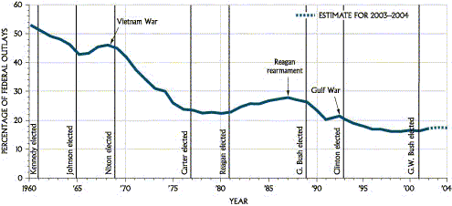
Trends in Defense Spending

Slide 37
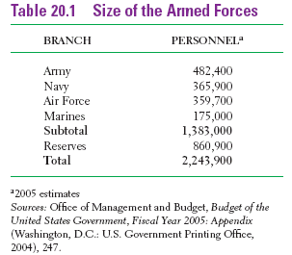
Armed defense

